Slide 1
EE2211 Tutorial 5
(remember to sign your attendance on the sheet of paper)

Slide 2
Lecture recap

Slide 3
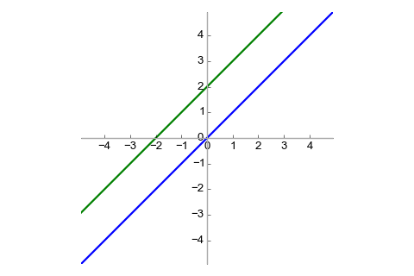
Linear and affine functions
Linear functions pass through the origin
e.g. y = ax
Affine functions are compositions of linear functions with a translation
e.g. y = ax + b
Linear functions are a particular case of affine functions when b = 0
All linear functions are affine, but not all affine functions are linear
affine
linear

Slide 4
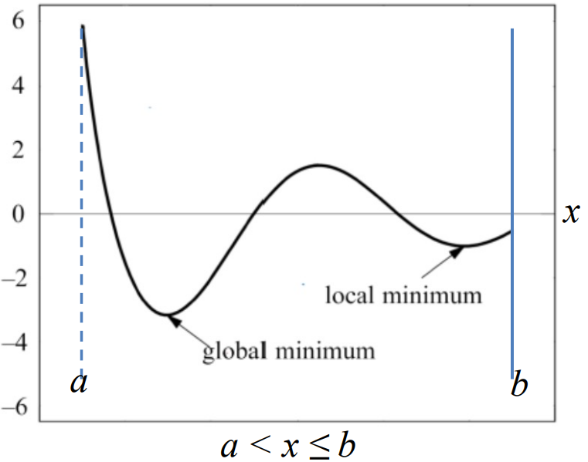
maximum and minimum

Slide 5
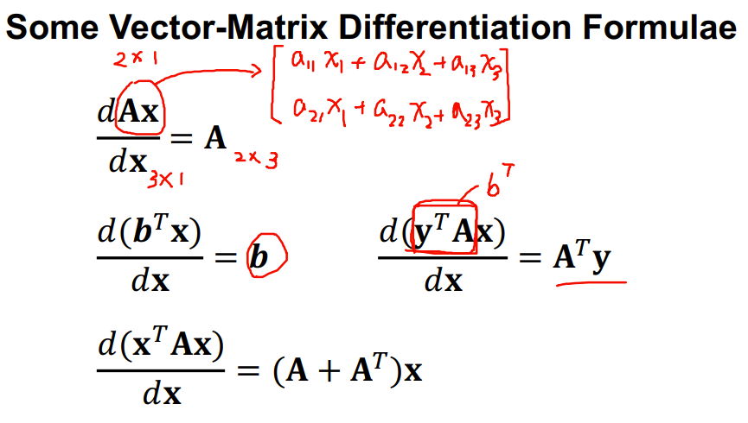
differentiation

Slide 6
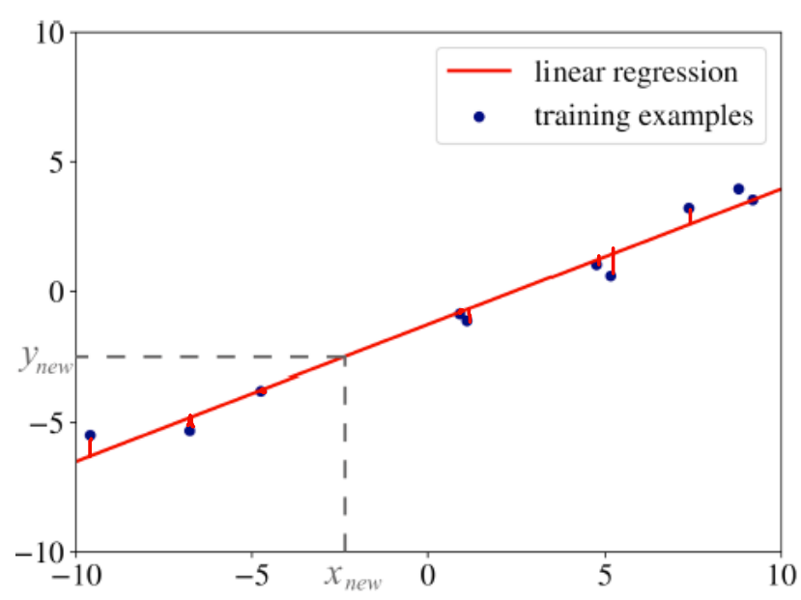
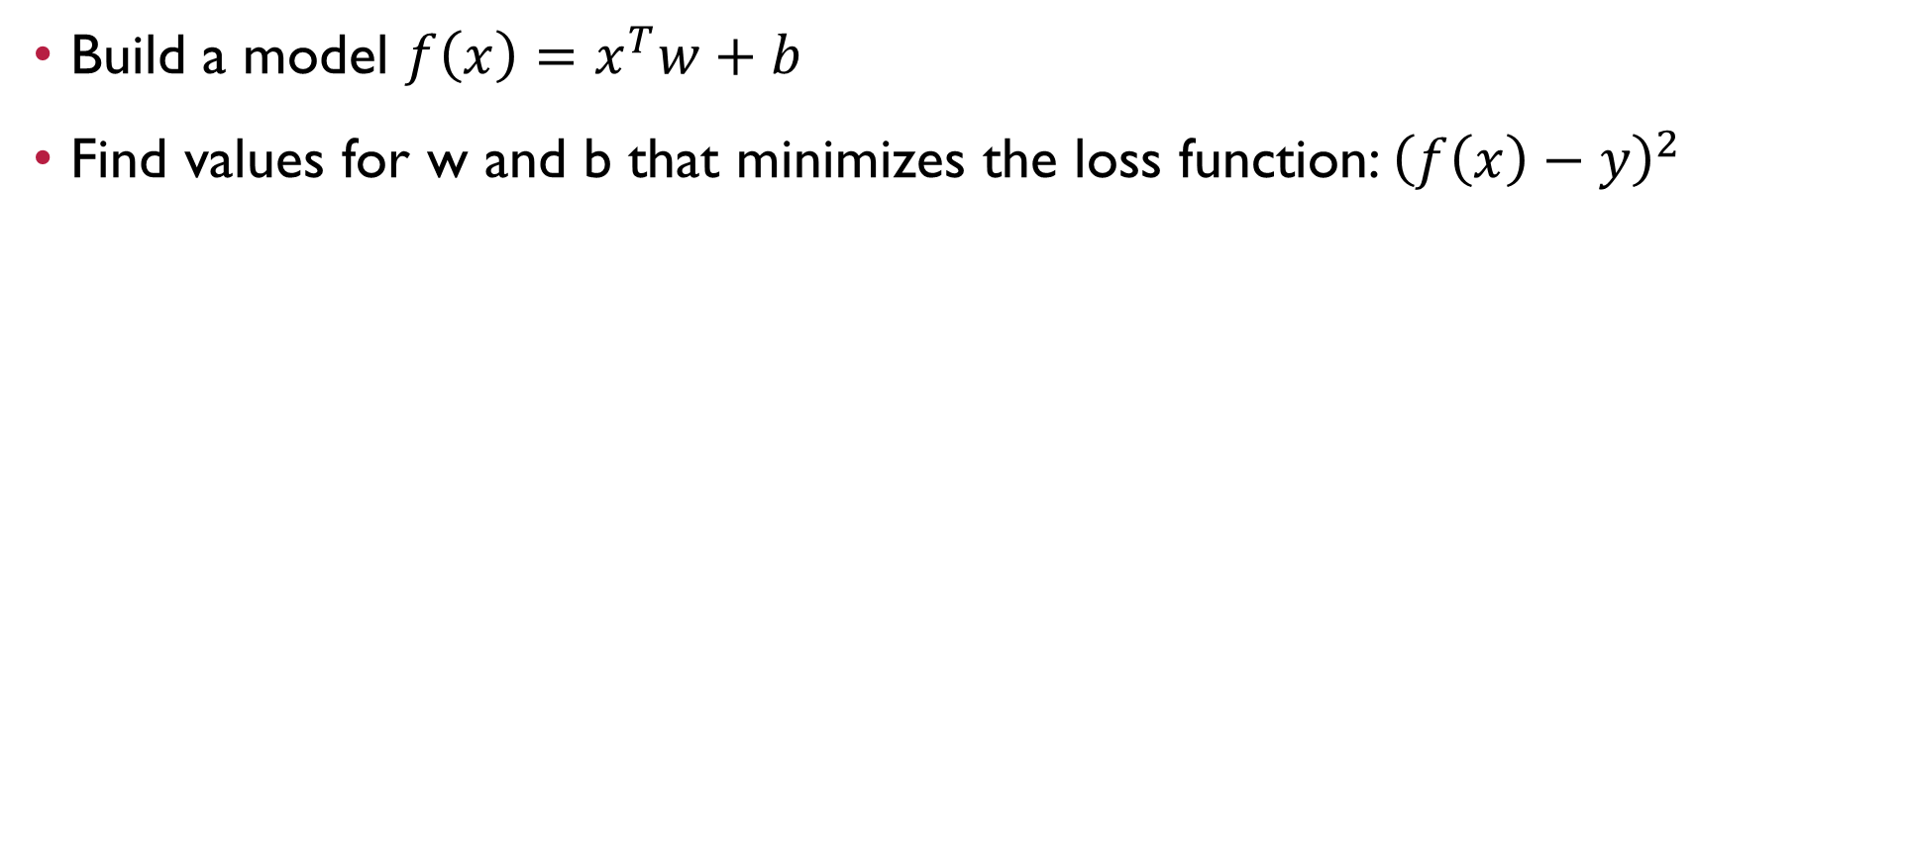
linear regression
Build a model $f\left(x\right)=x^{T}w+b$
Find values for w and b that minimizes the loss function: ${\left(f\left(x\right)−y\right)}^{2}$

Slide 7
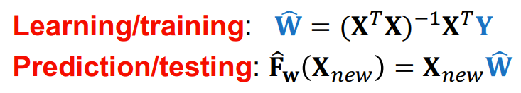
Linear regression

Slide 8
Tutorial 5

Slide 9
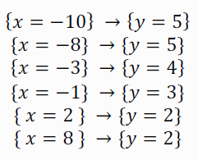
Question 1
Given the following data pairs for training:
Perform a linear regression with addition of a bias/offset term to the input feature vector and sketch the result of line fitting
Perform a linear regression without inclusion of any bias/offset term and sketch the result of line fitting
What is the effect of adding a bias/offset term to the input feature vector?

Slide 10
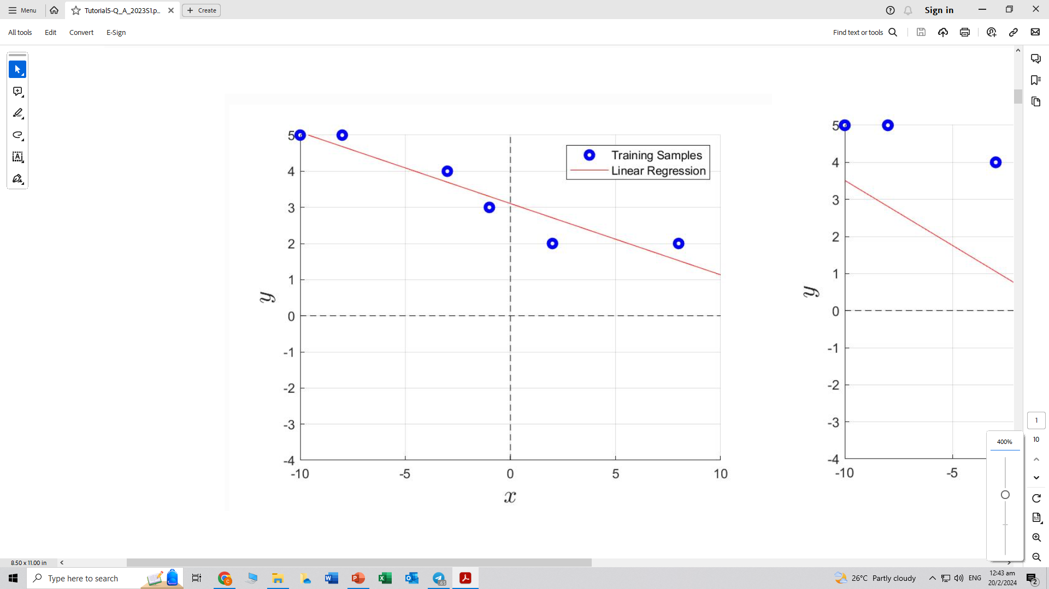
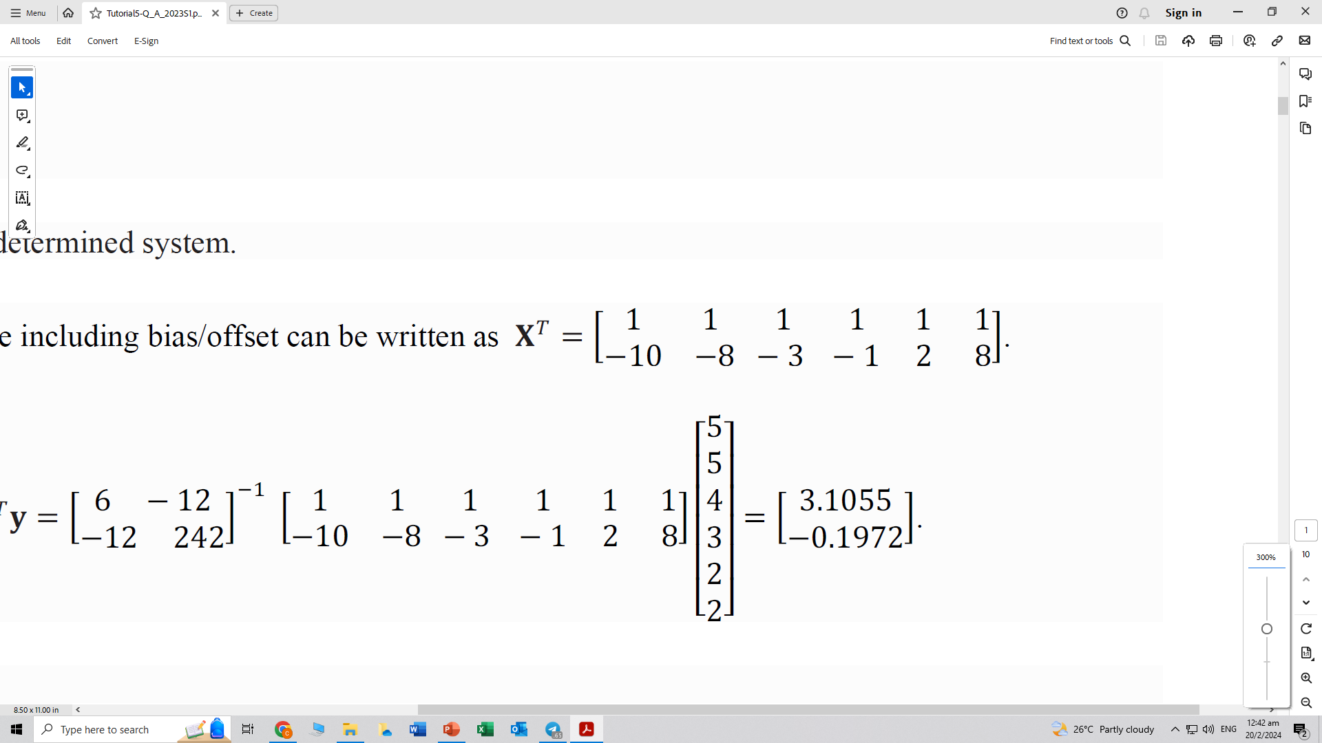
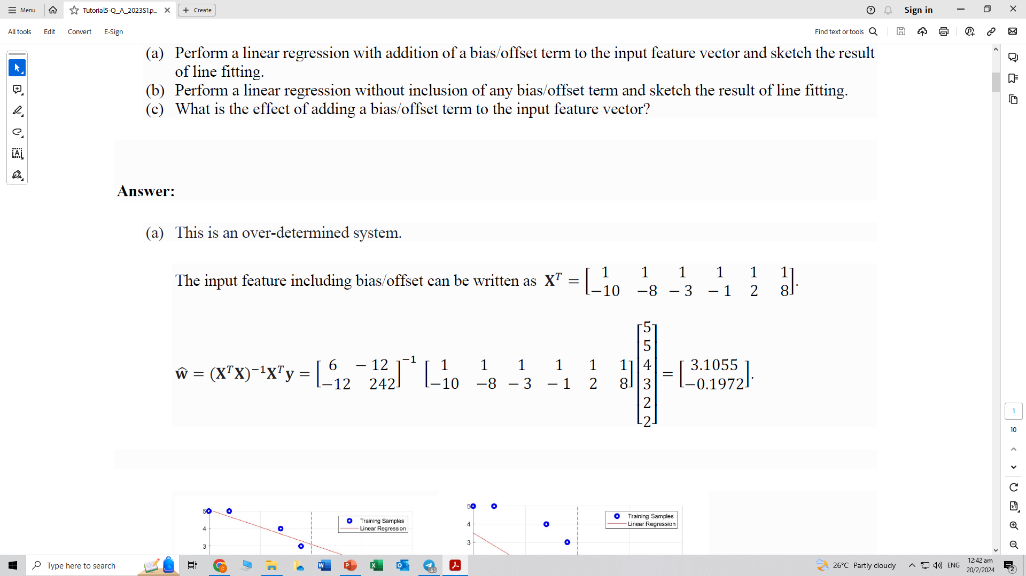
Question 1
Given the following data pairs for training:
Perform a linear regression with addition of a bias/offset term to the input feature vector and sketch the result of line fitting
Perform a linear regression without inclusion of any bias/offset term and sketch the result of line fitting
What is the effect of adding a bias/offset term to the input feature vector?
This is an over-determined system.
The input feature including bias/offset can be written as:

Slide 11
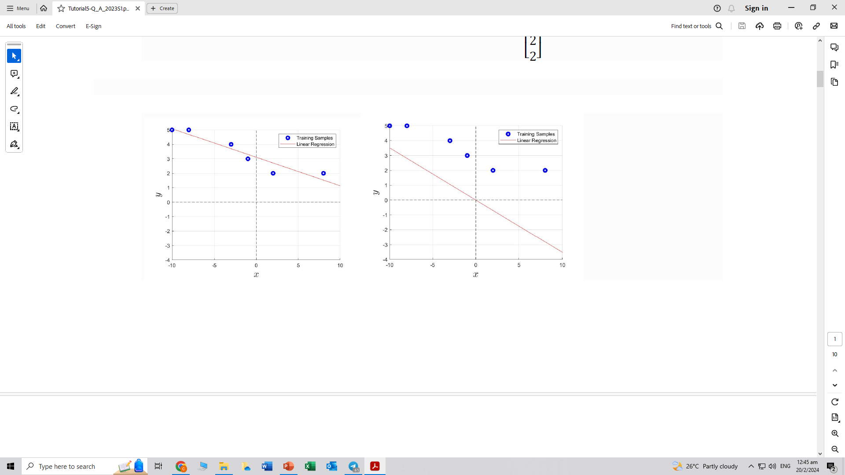
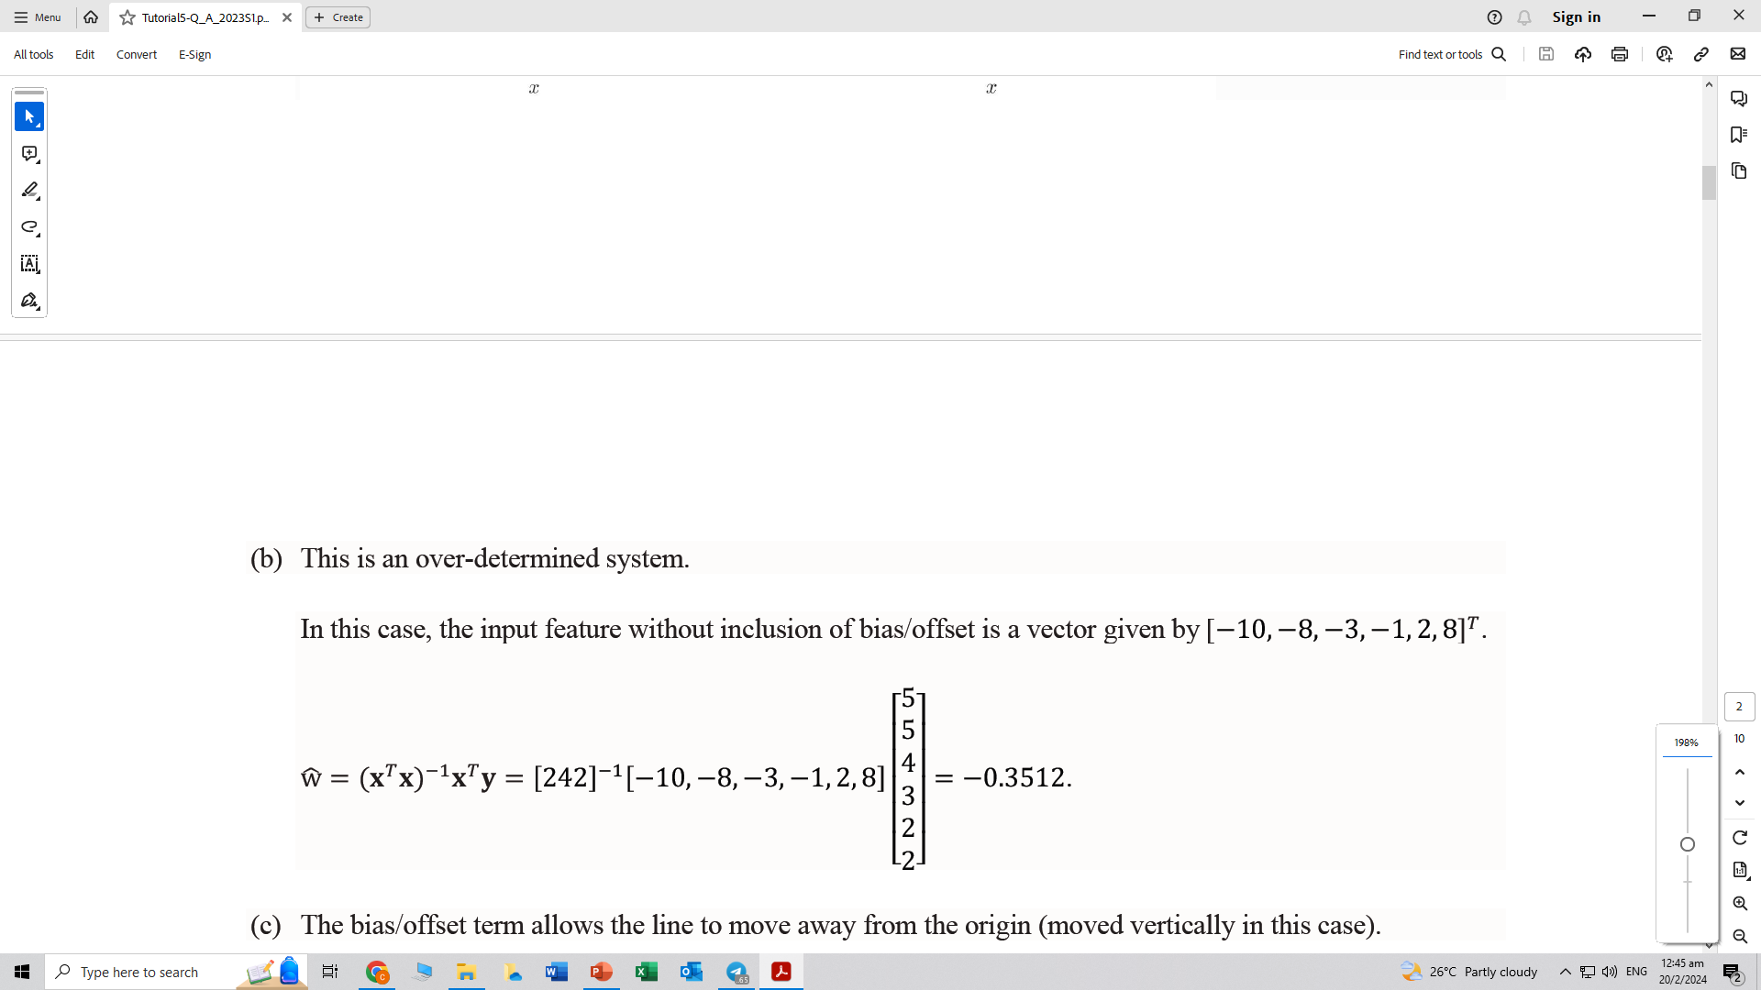
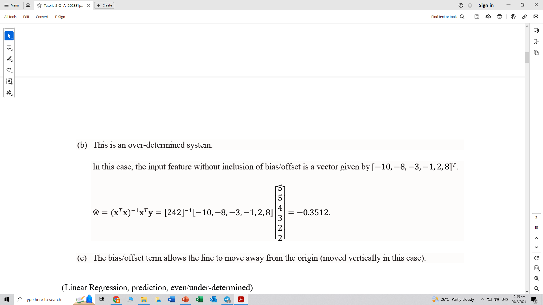
Question 1
Given the following data pairs for training:
Perform a linear regression without inclusion of any bias/offset term and sketch the result of line fitting
In this case, the input feature without inclusion
of bias/offset is a vector given by

Slide 12
Question 1
Given the following data pairs for training:
What is the effect of adding a bias/offset term to the input feature vector?
The bias/offset term allows the line to move away from the origin (moved vertically in this case).
With bias
Without bias

Slide 13
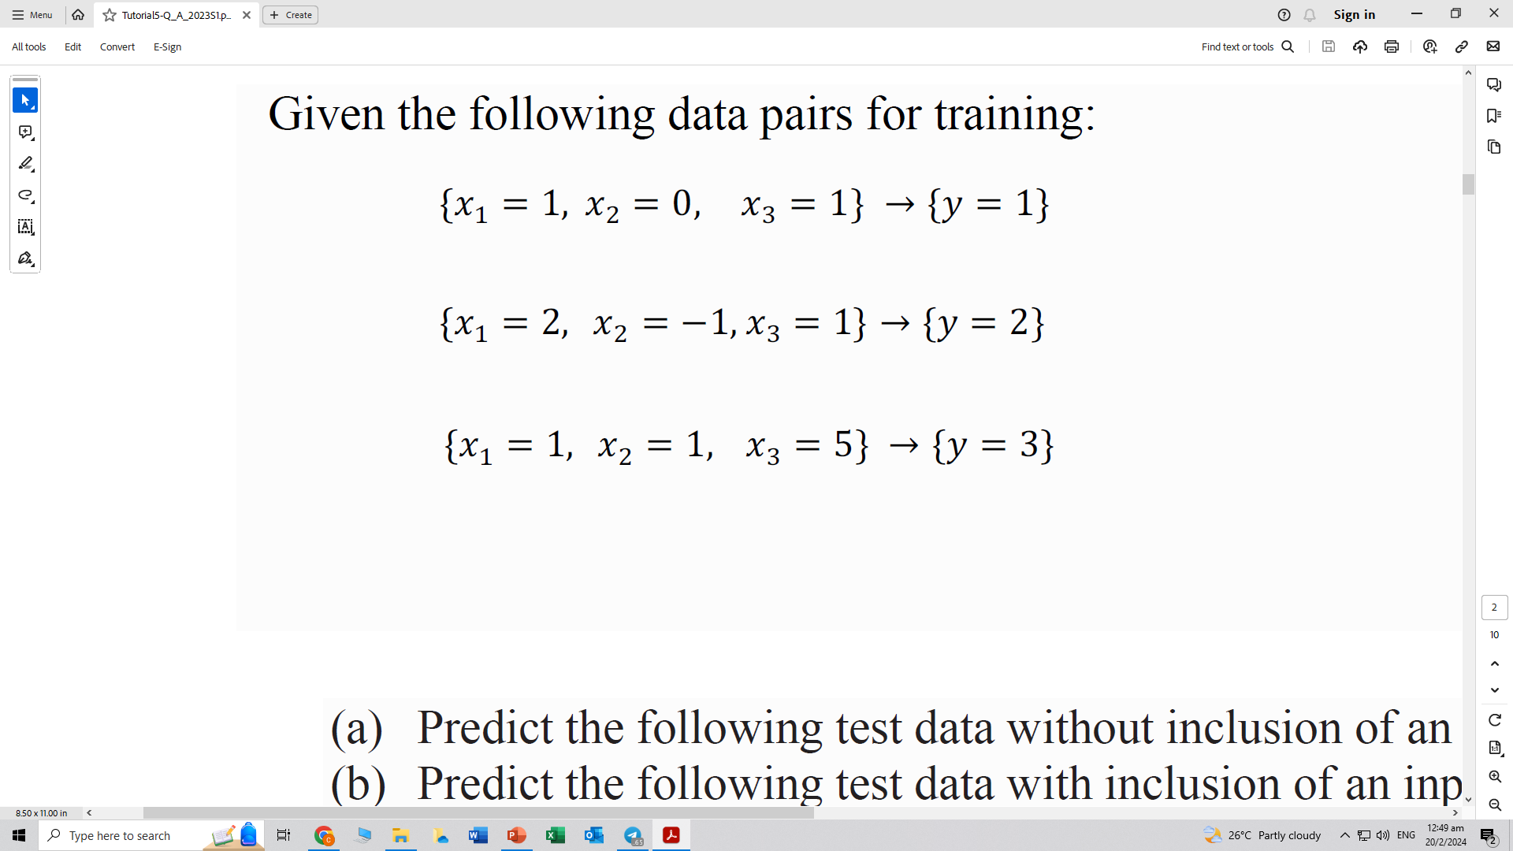
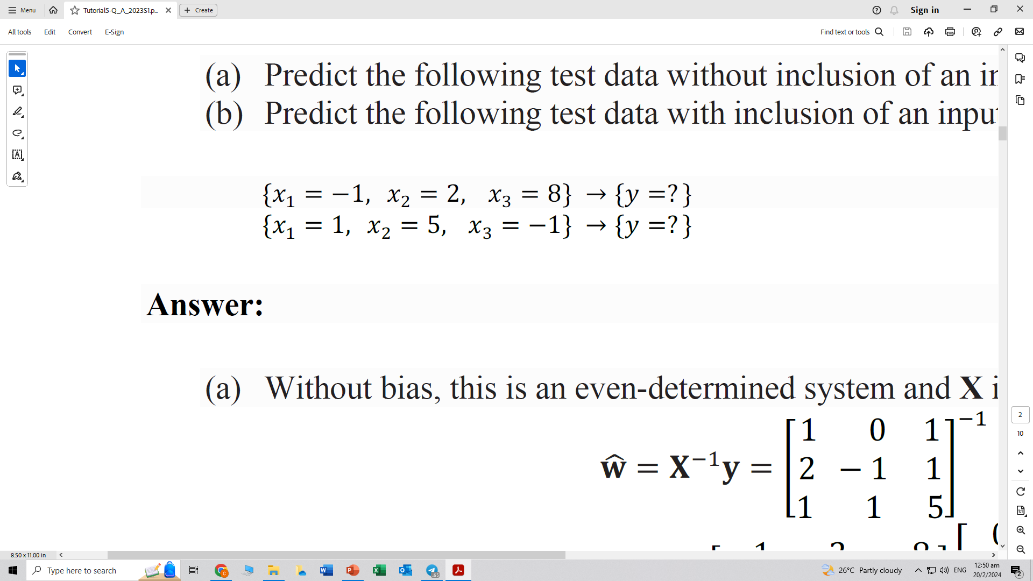
Question 2
Given the following data pairs for training:
Predict the following test data without inclusion of an input bias/offset term
Predict the following test data with inclusion of an input bias/offset term

Slide 14
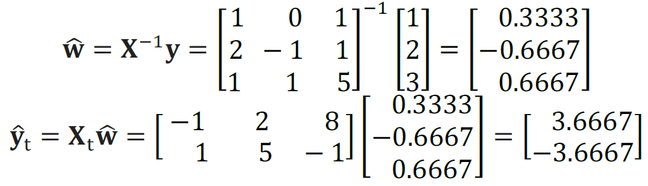
Question 2
Given the following data pairs for training:
Predict the following test data without inclusion of an input bias/offset term
Without bias, this is an even-determined system and X is invertible.

Slide 15
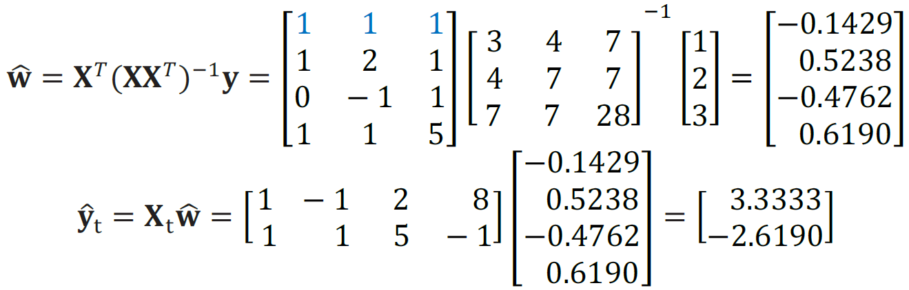
Question 2
Given the following data pairs for training:
Predict the following test data with inclusion of an input bias/offset term
After adding bias, it becomes an under-determined system.

Slide 16
Question 3
A college bookstore must order books two months before each semester starts. They believe that the number of books that will ultimately be sold for any particular course is related to the number of students registered for the course when the books are ordered. They would like to develop a linear regression equation to help plan how many books to order. From past records, the bookstore obtains the number of students registered, X, and the number of books actually sold for a course, Y, for 12 different semesters. These data are shown below.

Slide 17
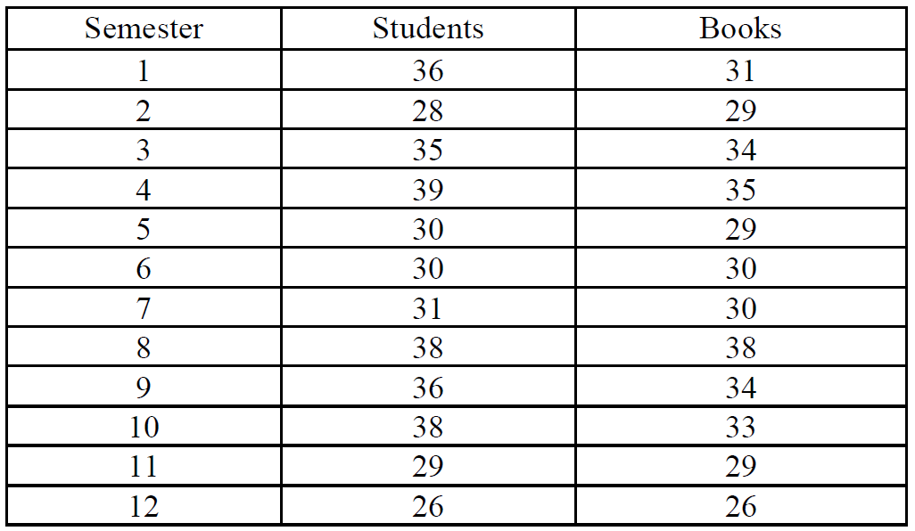
Question 3
A college bookstore must order books two months before each semester starts. They believe that the number of books that will ultimately be sold for any particular course is related to the number of students registered for the course when the books are ordered. They would like to develop a linear regression equation to help plan how many books to order. From past records, the bookstore obtains the number of students registered, X, and the number of books actually sold for a course, Y, for 12 different semesters. These data are shown below.

Slide 18
Question 3
Obtain a scatter plot of the number of books sold versus the number of registered students

Slide 19
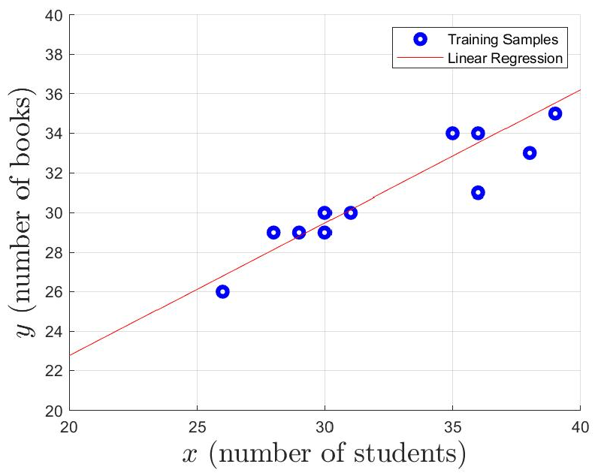
Question 3
Obtain a scatter plot of the number of books sold versus the number of registered students

Slide 20
Question 3
Write down the regression equation and calculate the coefficients for this fitting

Slide 21
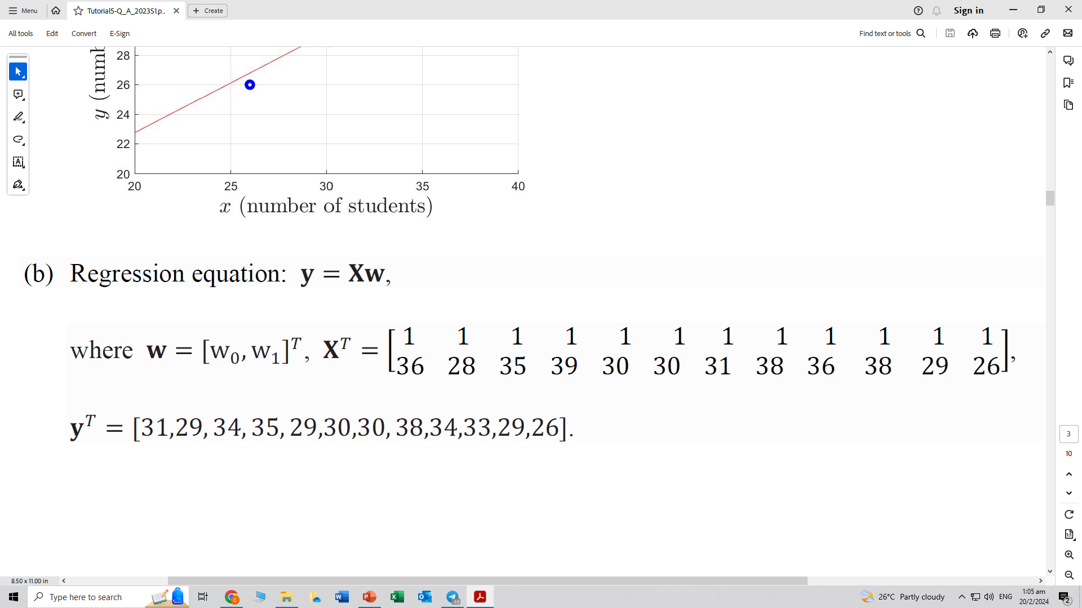
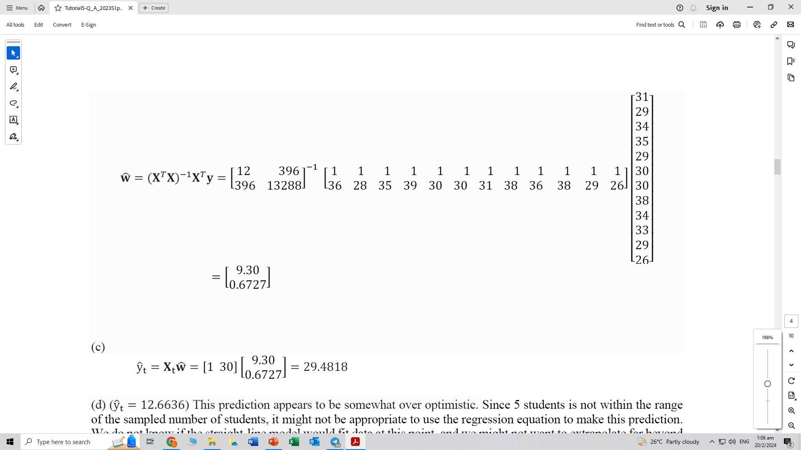
Question 3
Write down the regression equation and calculate the coefficients for this fitting
Regression equation: y = Xw

Slide 22
Question 3
Predict the number of books that would be sold in a semester when 30 students have registered

Slide 23
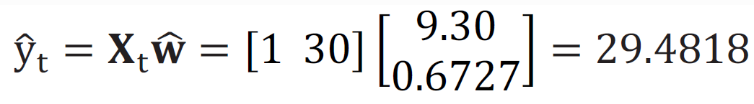
Question 3
Predict the number of books that would be sold in a semester when 30 students have registered

Slide 24
Question 3
Predict the number of books that would be sold in a semester when 5 students have registered

Slide 25
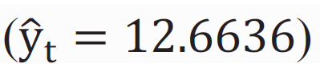
Question 3
Predict the number of books that would be sold in a semester when 5 students have registered
This prediction appears to be somewhat over optimistic. Since 5 students is not within the range of the sampled number of students, it might not be appropriate to use the regression equation to make this prediction. We do not know if the straight-line model would fit data at this point, and we might not want to extrapolate far beyond the observed range.

Slide 26
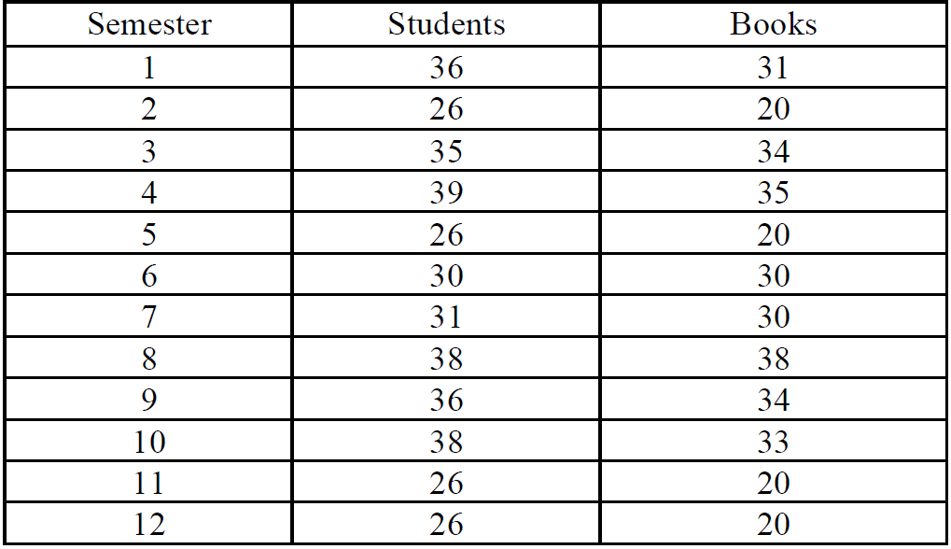
Question 4
Repeat the above problem using the following training data
Repeated data!

Slide 27
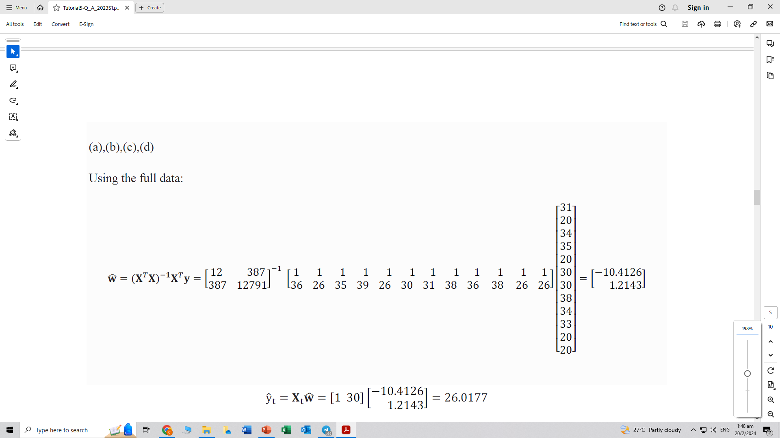
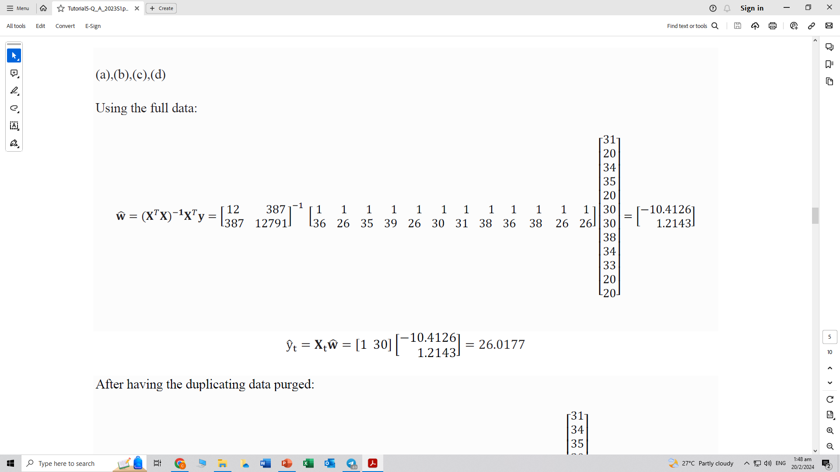
Question 4
Calculate the regression coefficients for this fitting

Slide 28
Question 4
Predict the number of books that would be sold in a semester when 30 students have registered

Slide 29
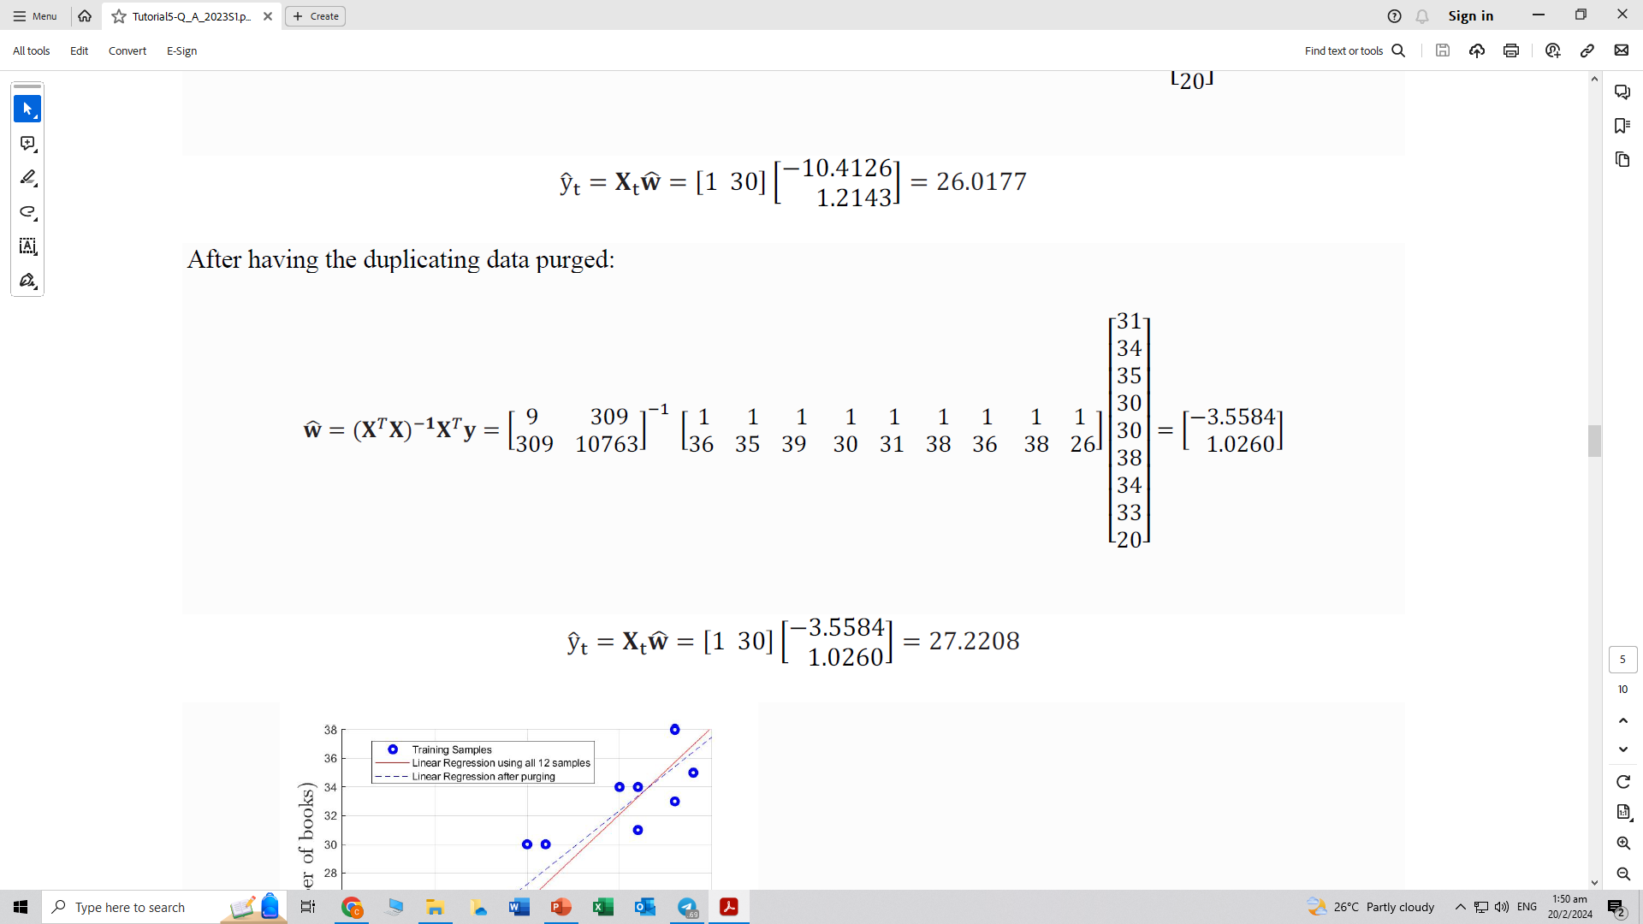
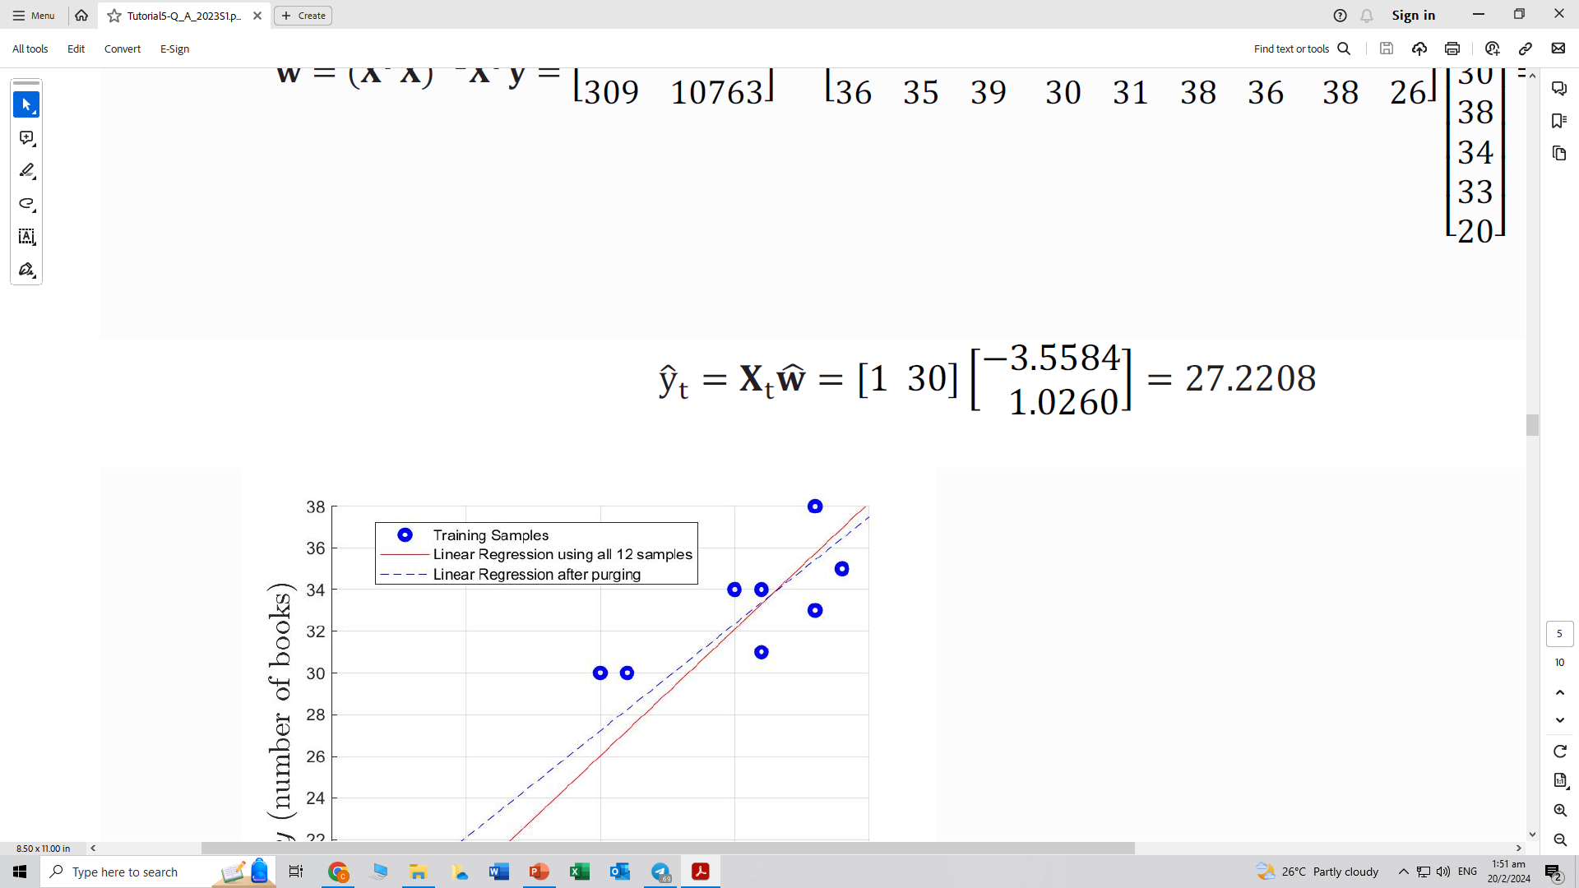
Question 4
Purge those duplicating data and re-fit the line and observe the impact on predicting the number of books that would be sold in a semester when 30 students have registered

Slide 30
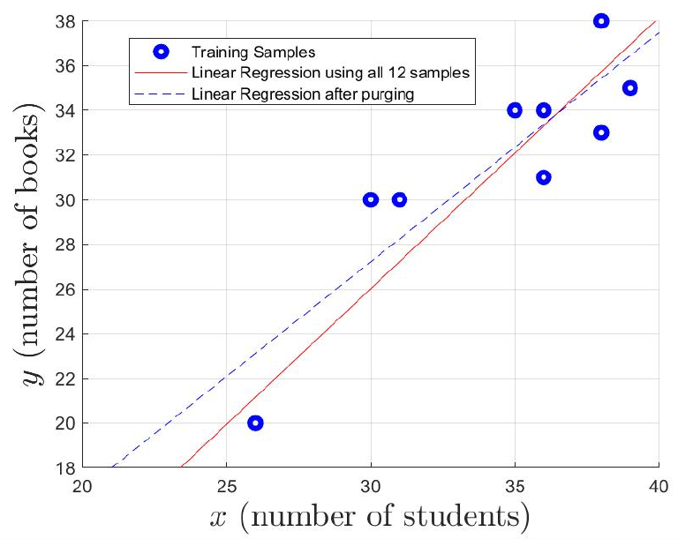
Question 4
Sketch and compare the two fitting lines
In this case, purging seems to give a more optimistic prediction for a relatively small number of students (< 37) and more conservative prediction for a relatively large number of students (>37)

Slide 31
Question 5 (python)
Predict the educational expenditure of year 2021 based on linear regression. Solve the problem using Python with a plot.

Slide 32
Question 6 (python)
Use Python to perform the following tasks:
Take y = wine.quality as the target output and x = wine.drop('quality',axis = 1)as the input features. Assume the given list of data is already randomly indexed (i.e., not in particular order), split the database into two sets: [0:1500] samples for regression training, and [1500:1599] samples for testing.
Perform linear regression on the training set and print out the learned parameters.
Perform prediction using the test set and provide the prediction accuracy in terms of the mean of squared errors (MSE).

Slide 33
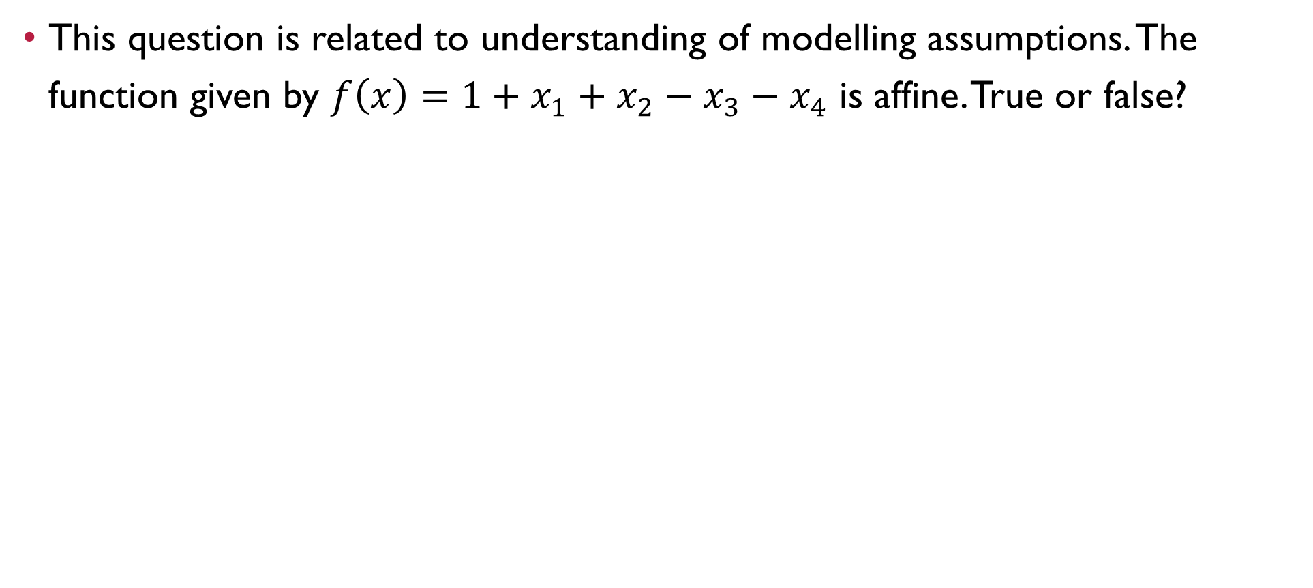
Question 7
This question is related to understanding of modelling assumptions. The function given by $f\left(x\right)=1+x_{1}+x_{2}−x_{3}−x_{4}$ is affine. True or false?

Slide 34
Question 7
This question is related to understanding of modelling assumptions. The function given by $f\left(x\right)=1+x_{1}+x_{2}−x_{3}−x_{4}$ is affine. True or false?
True

Slide 35
Question 8
Suppose 𝑓(𝐱) is a scalar function of d variables where 𝐱 is a d ×1 vector. Then, without taking data points into consideration, the outcome of differentiation of 𝑓(𝐱) w.r.t. 𝐱 is
a scalar
a d×1 vector
a d×d matrix
a d×d×d tensor
None of the above

Slide 36
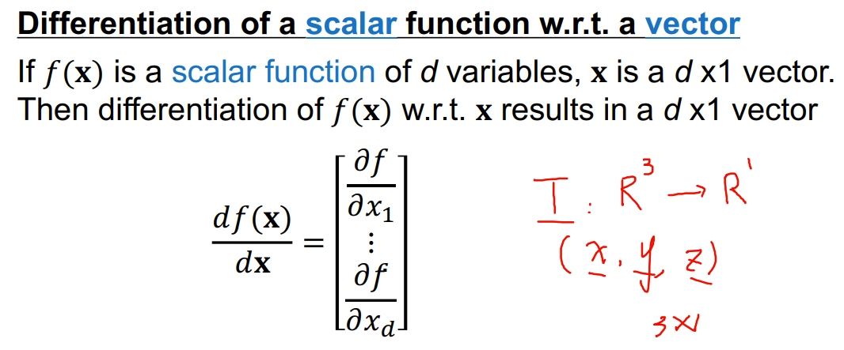
Question 8
Suppose 𝑓(𝐱) is a scalar function of d variables where 𝐱 is a d ×1 vector. Then, without taking data points into consideration, the outcome of differentiation of 𝑓(𝐱) w.r.t. 𝐱 is
a scalar
a d×1 vector
a d×d matrix
a d×d×d tensor
None of the above

Slide 37
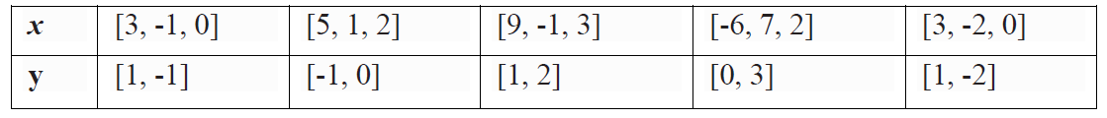
Question 9 (python)
The values of feature vector x and their corresponding values of target vector y are shown in the table below:
Find the least square solution of w using linear regression of multiple outputs and then estimate the value of y when x = [8, 0, 2].

Slide 38
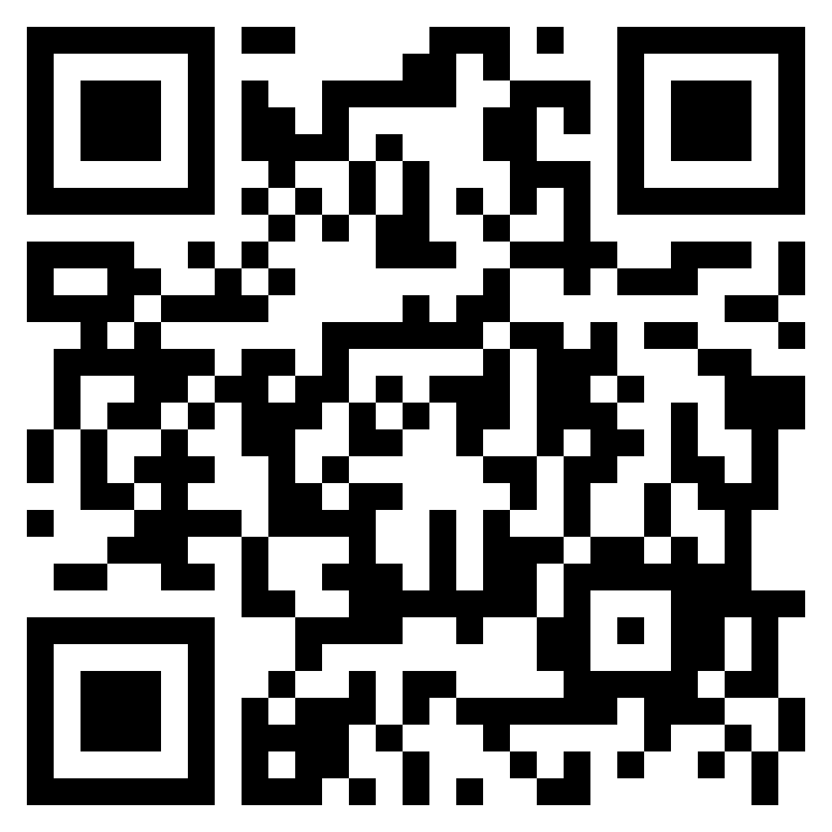

Questions?
Feel free to come up to me if you have any questions about anything!
If you are shy, you can use the anonymous form to leave questions & feedback about the tutorial.
You can also reach out to me on our Telegram group or PM me at @eehongchan
Anonymous feedback
Telegram
https://forms.gle/c9QU94YcWjR3EZFk9

